Slide 1
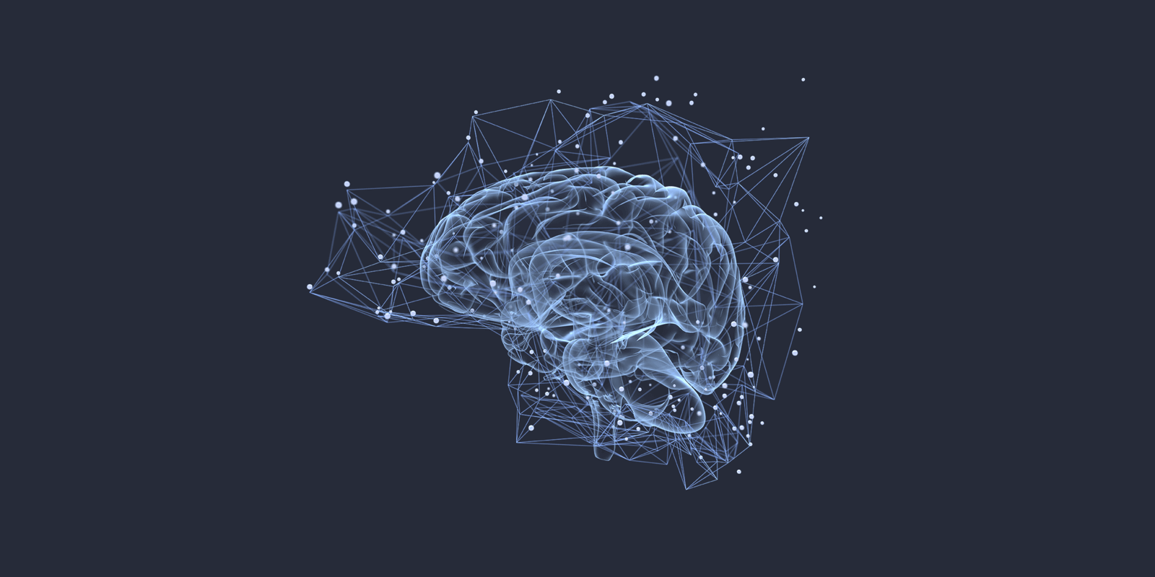
A Neurocognitive Study of SIMKAP Multitasking Workload with EEG
Team ON2 : Fantastic 5 Project 7
Team Members : Tithi Paul, Deeksha, Pranjali, Sriya Ravula, Siddharth Prakash

Slide 2
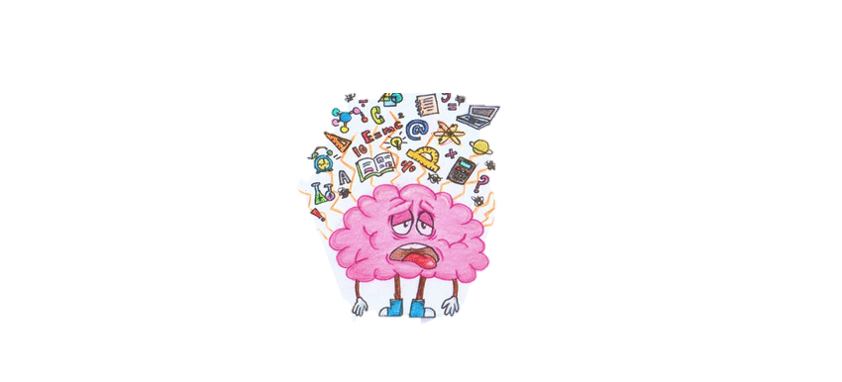



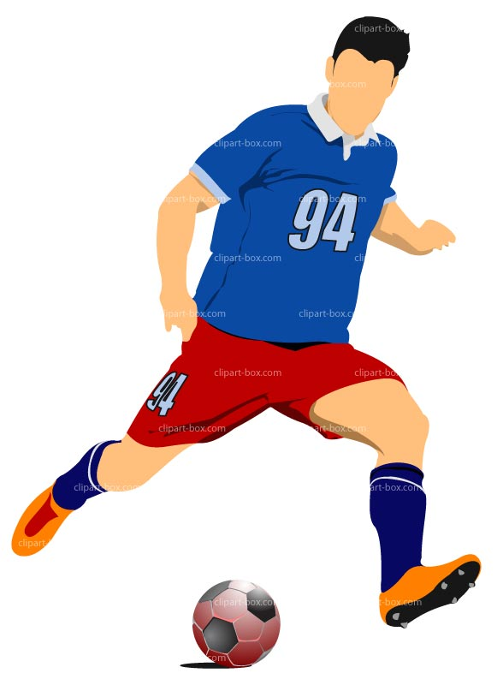

Why did we choose this project?
Reliability and validity of task
Relevance in clinical and non-clinical populations
For example ADHD, Autism, Depression, Anxiety
EEG testing allows for temporal accuracy
Application
Ecological cognition
with the help of cognitive workload
The tool used for assessment has robust validity and reliability, and it provides an objective measure of multitasking and stress tolerance.
and building on existing literature about corresponding spatial neural research, this study can provide deeper insights into understanding the mechanisms of action with precision.
HCI research, fields with high cognitive demand like aviation, sport and military, neuromarketing among others.

Slide 3
What are the objectives of this project?
Project Objectives
EEG Analysis
Temporal and Spectral Features
Objective Workload Assessment
Neurocognitive Insights

Slide 4
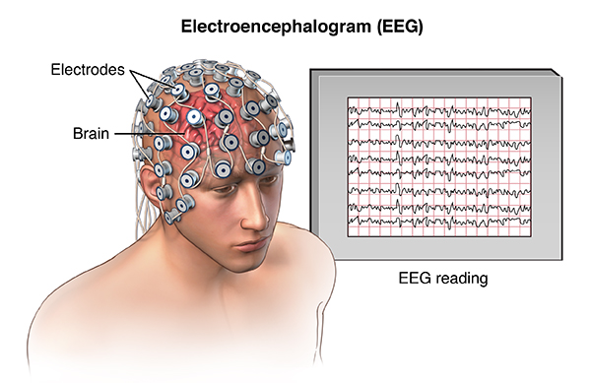
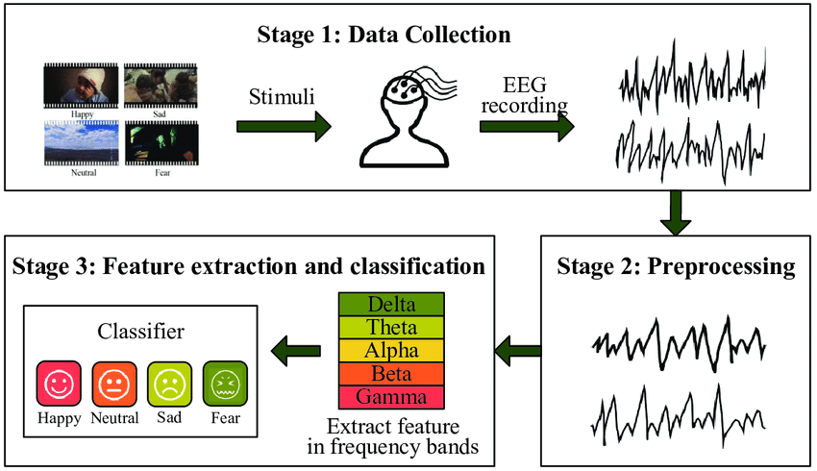
Introduction to Dataset
The EEG data was collected with Emotiv EPOC EEG headset, Sampling frequency> 128Hz, 16 bit A/D resolution
Electrodes: 10-20 system, AF3/4. F7/8, F3/4, FC5/6 relevant out of the 14 channels as per lit review
N(48), (t)=2.5 min
Data divided into high vs low MWL conditions (subjective Likert rating scale)
Dataset preprocessed for line noise and large amplitude artifacts, high pass filtered at 1Hz, and re-referenced to average
High Moderate Low

Slide 5
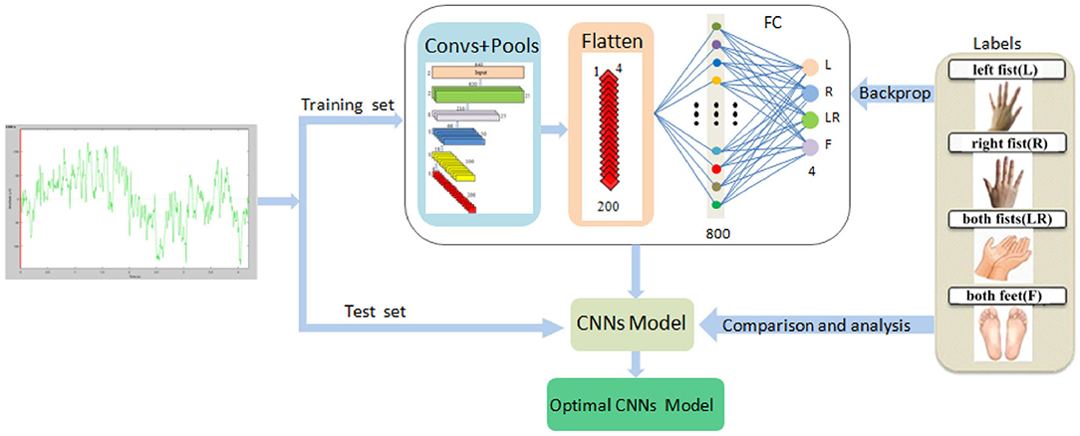
Project Methodology
L
E
B
E
L
S
CNN Model
Feature extraction→Data Splitting→Model Evaluation
Interpretation and Visualization

Slide 6
CNNs excel in this context for several reasons:
Spatial Sensitivity
EEG data, with its spatial distribution of electrodes across the scalp, can benefit from CNN's inherent spatial sensitivity. CNNs are well-suited to detect localized patterns in EEG signals associated with varying cognitive workloads.
Hierarchical Feature Learning
CNNs are adept at automatically learning hierarchical features, which is particularly valuable when dealing with the multi-scale nature of EEG data.
Data-Driven Representation
By training the CNN model on the provided pre-processed EEG data, the network can autonomously learn discriminative features, mitigating the need for manually crafted feature engineering.
Scalability and Generalization
CNNs offer a scalable solution that can generalize well to previously unseen EEG samples, making them an ideal choice for classifying mental workload in a dynamic and diverse setting like the SIMKAP multitasking test.

Slide 7
Discussion

Slide 8
Future Work

Slide 9
References

